Slide 1

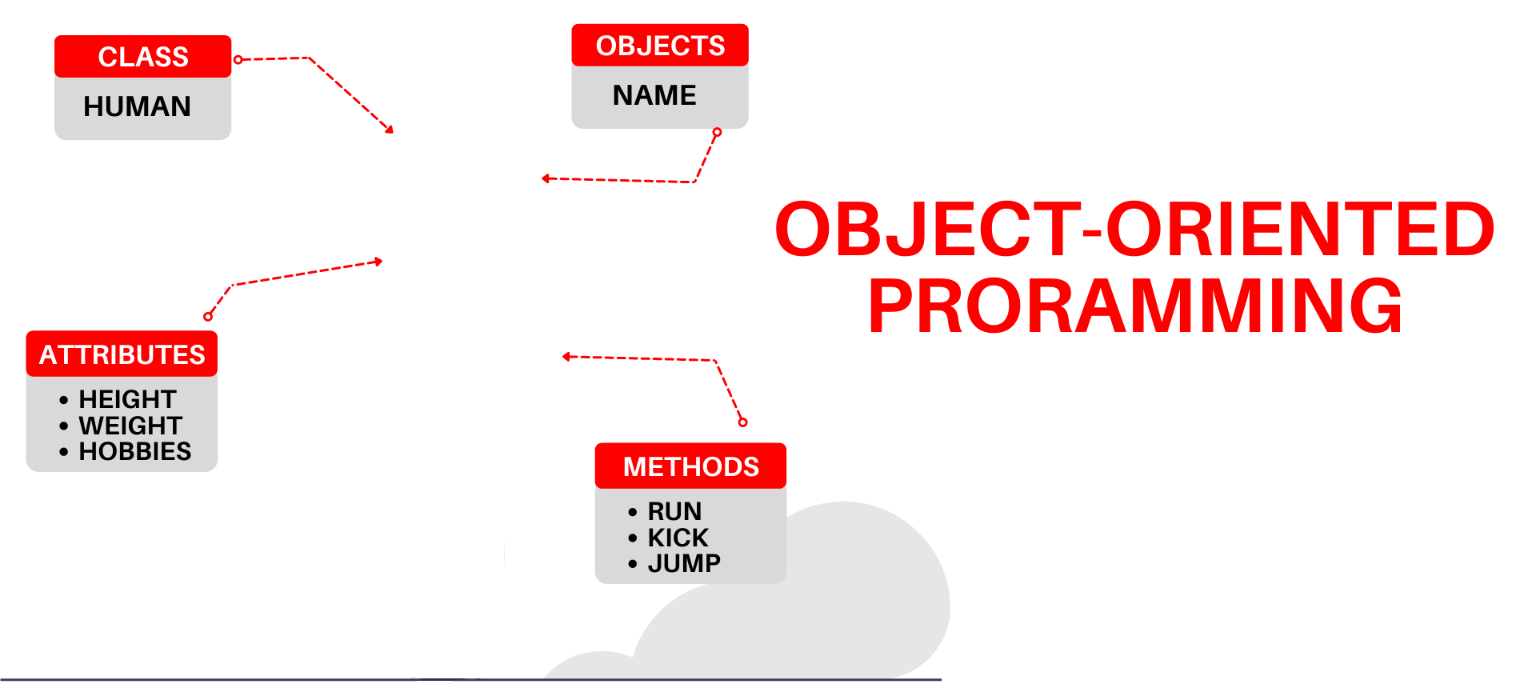

National University of Computer and Emerging Sciences
Spring 2022
Hira Naveed
Lecture # 10 Polymorphism

Slide 2
Polymorphism
Combination of two Greek words
Poly (many) morphism (form)
Water -> Solid, Liquid, Gas
For example, A Person
Same person have different behavior in different situations. This is called Polymorphism.
In shopping mall, behaves like a customer
In metro bus, behaves like a passenger
In university, behaves like a student
In home, behaves like a daughter/son

Slide 3
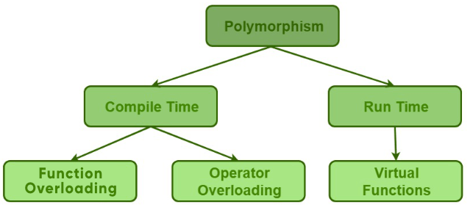
Polymorphism
Static Polymorphism/ Dynamic Polymorphism/
Static Binding Dynamic Binding

Slide 4
Binding Process
Binding is the process to associate variable/ function names with memory addresses
Binding is done for each variable and functions.
For functions, it means that matching the call with the right function definition by the compiler.

Slide 5
Compile-time Binding (Static Binding)
Compile-time binding is to associate a function's name with the entry point (start memory address) of the function at compile time (also called early binding)
Start address if
sayHi() function

Slide 6
Run-time Binding (Dynamic Binding)
Run-time binding is to associate a function's name with the entry point (start memory address) of the function at run time (also called late binding)
C++ provides both compile-time and run-time bindings:
Non-Virtual functions (you have implemented so far) are binded at compile time
Virtual functions (in C++) are binded at run-time.
Why virtual functions are used?
To implement Polymorphism

Slide 7
Static Polymorphism
int main() {
SomeClass obj1;
// The first 'func' is called
obj1.func(7);
// The second 'func' is called
obj1.func(9.132);
// The third 'func' is called
obj1.func(85,64);
return 0;
}
//Function Overloading
class SomeClass
{
public:
// function with 1 int parameter
void func(int x)
{
cout << "value of x is " << x << endl;
}
// function with same name but 1 double parameter
void func(double x)
{
cout << "value of x is " << x << endl;
}
// function with same name and 2 int parameters
void func(int x, int y)
{
cout << "value of x and y is " << x << ", " << y << endl;
}
};

Slide 8
Dynamic Polymorphism
There is an inheritance hierarchy
There is a pointer/reference of base class type that can point/refer to derived class objects

Slide 9
Pointers to Derived Classes
C++ allows base class pointers or references to point/refer to both base class objects and also all derived class objects.
Let’s assume:
class Base { … };
class Derived : public Base { … };
Then, we can write:
Base *p1;
Derived d_obj; p1 = &d_obj;
Base *p2 = new Derived;

Slide 10
Pointers to Derived Classes (contd.)
While it is allowed for a base class pointer to point to a derived object, the reverse is not true.
base b1;
derived *pd = &b1; // compiler error

Slide 11
Pointers to Derived Classes (contd.)
Access to members of a class object is determined by the type of
An object name (i.e., variable, etc.)
A reference to an object
A pointer to an object

Slide 12
Pointers to Derived Classes (contd.)
Using a base class pointer (pointing to a derived class object) can access only those members of the derived object that were inherited from the base.
This is because the base pointer has knowledge only of the base class.
It knows nothing about the members added by the derived class.
Notes:
A base class pointer can point to a derived class object, but we can only access base class member or virtual functions using the base class pointer because object slicing happens when a derived class object is assigned to a base class object. Additional attributes of a derived class object are sliced off to form the base class object.

Slide 13

Pointer of Base Class
class A {
public:
void func() {
cout << "A's func" << endl;
}
};
class B:public A {
public:
void func() {
cout << "B's func" << endl;
}
};
void main() {
B b;
//pointer of class type A points to
//object of child class B
A* a = &b;
a->func(); //calls A's func
}

Slide 14
Reference of Base Class
class A {
public:
void func() {
cout << "A's func" << endl;
}
};
class B:public A {
public:
void func() {
cout << "B's func" << endl;
}
};
void main() {
B b;
//reference of class type A refers to
//object of child class B
A& a = b;
a.func(); //calls A's func
}

Slide 15
Pointer of Base Class
Parent class pointer/reference has NO KNOWLEDGE of child class functions
class A {
public:
void func() {
cout << "A's func" << endl;
}
};
class B:public A {
public:
void func() {
cout << "B's func" << endl;
}
void foo() {}
};
void main() {
//pointer of class type A points to
//object of child class B
A* a = new B;
a->foo(); //ERROR
}

Slide 16
Summary – Based and Derived Class Pointers
Base-class pointer pointing to base-class object
Straightforward
Derived-class pointer pointing to derived-class object
Straightforward
Base-class pointer pointing to derived-class object
Safe
Can access non-virtual methods of only base-class
Can access virtual methods of derived class
Derived-class pointer pointing to base-class object
Compilation error

Slide 17
Dynamic Polymorphism
There is an inheritance hierarchy
There is a pointer/reference of base class type that can point/refer to derived class objects
There is a pointer of base class type that is used to invoke virtual functions of derived class.
The first class that defines a virtual function is the base class of the hierarchy that uses dynamic binding for that function name and signature.
Each of the derived classes in the hierarchy must have a virtual function with same name and signature. Not an error but needed for dynamic binding

Slide 18
Virtual Functions
Virtual functions ensure that the correct function is called for an object, regardless of the type of reference (or pointer) used for function call
They are mainly used to achieve Runtime polymorphism
Functions are declared with a virtual keyword in base class
The resolving of function call is done at runtime
Notes:
See inheritance5.h and pr15-03.cpp

Slide 19
Virtual Functions
The virtual-ness of an operation is always inherited
If a function is virtual in the base class, it must be virtual in the derived class
Even if the keyword “virtual” not specified (But always use the keyword in children classes for clarity.)
If no overridden function is provided, the virtual function of base class is used
Notes:
See inheritance5.h and pr15-03.cpp

Slide 20
Virtual function
Declaring a function virtual will ensure late-binding
To declare a function virtual, we use the Keyword virtual:
class Shape
{
public:
virtual void sayHi ()
{
cout <<“Just hi! \n”;
}
};

Slide 21

Virtual function
class A {
public:
virtual void func() {
cout << "A's func" << endl;
}
};
class B:public A {
public:
void func() { //automatically virtual
cout << "B's func" << endl;
}
};
void main() {
B b;
//pointer of class type A points to
//object of child class B
A* a = &b;
a->func(); //calls B's func
}

Slide 22
Virtual function
Overridden function parameters in derived class must be same as base class, otherwise base class func will be called
class A {
public:
virtual void func() {
cout << "A's func" << endl;
}
};
class B:public A {
public:
void func(int a) { //automatically virtual
//BUT, parameters don't match base class func()
cout << "B's func" << endl;
}
};
void main() {
B b;
//pointer of class type A points to
//object of child class B
A* a = &b;
a->func(); //calls A's func
}

Slide 23
Virtual function
Override keyword
class A {
public:
virtual void func() {
cout << "A's func" << endl;
}
};
class B:public A {
public:
void func() override { //automatically virtual
//use override keyword to ensure parameters match
cout << "B's func" << endl;
}
};
void main() {
B b;
//pointer of class type A points to
//object of child class B
A* a = &b;
a->func(); //calls B's func
}

Slide 24

Virtual function with Multilevel Inheritance
class A {
public:
virtual void func() {
cout << "A's func" << endl;
}
};
class B:public A {
public:
void func() override { //automatically virtual
//use override keyword to ensure parameters match
cout << "B's func" << endl;
}
};
class C :public B {
public:
void func() override { //automatically virtual
//use override keyword to ensure parameters match
cout << "C's func" << endl;
}
};
void main() {
//pointer of class type A points to
//object of grandchild class C
A* a = new C;
a->func(); //calls C's func
}

Slide 25
Virtual function with Multilevel Inheritance
Class C does not override func(), if parent of class C has func(), that one is executed
class A {
public:
virtual void func() {
cout << "A's func" << endl;
}
};
class B:public A {
public:
void func() override { //automatically virtual
//use override keyword to ensure parameters match
cout << "B's func" << endl;
}
};
class C :public B {};
void main() {
//pointer of class type A points to
//object of grandchild class C
A* a = new C;
a->func(); //calls B's func
}

Slide 26
Virtual function with Multilevel Inheritance
Class C does not override func(), class B also does not override func(),
A’s func is executed
class A {
public:
virtual void func() {
cout << "A's func" << endl;
}
};
class B:public A {};
class C :public B {};
void main() {
//pointer of class type A points to
//object of grandchild class C
A* a = new C;
a->func(); //calls A's func
}

Slide 27
Virtual Functions
If the member function definition is out-of-line, the keyword virtual must not be specified again.
Virtual functions can not be stand-alone or static functions
A destructor can be virtual but a constructor cannot
Notes:
See inheritance5.h and pr15-03.cpp

Slide 28
Virtual Functions based Shapes

Slide 29
Virtual Functions
How to declare a member function virtual:
class Animal{
public:
virtual void id(){cout << "animal";}
};
class Cat : public Animal{
public:
virtual void id(){cout << "cat";}
};
class Dog : public Animal{
public:
virtual void id(){cout << "dog";}
};

Slide 30
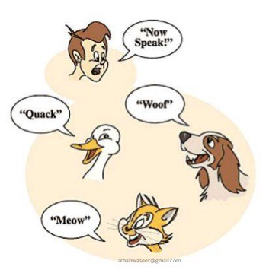
Virtual Functions
If the member functions id( ) are declared virtual, then the code:
Animal *pA[] = {new Animal, new Dog, new Cat};
for(int i=0; i<3; i++)
pA[i]->id();
will print animal, dog, cat
Notes:
See inheritance5.h and pr15-03.cpp

Slide 31
With Multiple Inheritance
class A {
public:
void print() { //not virtual
cout << "Print class A" << endl;
}
~A() {
cout << "A's destructor" << endl;
}
};
class B {
public:
virtual void print() {
cout << "Print class B" << endl;
}
~B() {
cout << "B's destructor" << endl;
}
};
class C :public B,public A {
public:
void print() {
cout << "Print class C" << endl;
}
~C() {
cout << "C's destructor" << endl;
}
};
int main() {
B *b=new C;
A* a=new C;
b->print();
a->print();
return 0;
}
Output:
Print class C
Print class A

Slide 32
Benefits of Polymorphism
Better Design!
Flexibility
You can always change the subclass object assigned to the superclass reference variable, without breaking other code
The modification will only affect the new object, not those using it
Need to Write Less code
Reference variable of superclass type can be assigned object of any subclass
Easy to Extend
Write code that doesn’t have to change when you introduce new subclass types into the program.

Slide 33
Pointers to Derived Classes
We can create an array of base class pointers, and these pointers can hold objects of different derived classes
Shape *p[4];
p[0] = new Triangle (3, 4, 5, 19 );
p[1] = new Circle (3, 4, 5 );
p[2] = new Rectangle ( 3, 4, 10 , 20 );
p[3] = new Cylinder ( 3, 4, 5, 10 );
for ( int loop = 0; loop < 4; loop ++ )
{ p[loop]->draw ();
cout << “The area is “ << p[loop]->GetArea ( );
}

Slide 34
Dynamic Polymorphism Example (using Base Class’s Pointers and References)

Slide 35
Virtual Destructors
Constructors cannot be virtual, but destructors can be virtual when a constructor of a class is executed there is no virtual table in the memory, means no virtual pointer defined yet.
Ensures the derived class destructor is called when a base class pointer is used, while deleting a dynamically created derived class object.
virtual ~Shape(){….}
Reason: to invoke the correct destructor, no matter how object is accessed

Slide 36
Virtual Destructors (contd.)
class base {
public:
~base() {
cout << “destructing base\n”;
}
};
class derived : public base {
public:
~derived() {
cout << “destructing derived\n”;
}
};
int main()
{
base *p = new derived;
delete p;
return 0;
}
Output:
destructing base
Using non-virtual destructor

Slide 37
Virtual Destructors (contd.)
class base {
public:
virtual ~base() {
cout << “destructing base\n”;
}
};
class derived : public base {
public:
~derived() {
cout << “destructing derived\n”;
}
};
int main()
{
base *p = new derived;
delete p;
return 0;
}
Output:
destructing derived
destructing base
Using virtual destructor

Slide 38
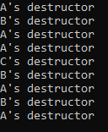
class A {
public:
void print(int b) {
cout << "Print class A" << endl;
}
~A() {
cout << "A's destructor" << endl;
}
};
class B :public A {
public:
void print(int a=0) {
cout << "Print class B" << endl;
}
~B() {
cout << "B's destructor" << endl;
}
};
class C :public B {
public:
~C() {
cout << "C's destructor" << endl;
}
};
int main() {
B *b=new B;
A* a=new A;
delete a;
delete b;
B bb;
C c;
A aa;
return 0;
}
For dynamic objects, destructors are called with delete only and in the order of delete statements.
For simple objects (in the same scope) destructors are called in opposite order. i.e. the one declared last is destroyed first.
Without delete, destructor is not called for dynamic objects

Slide 39
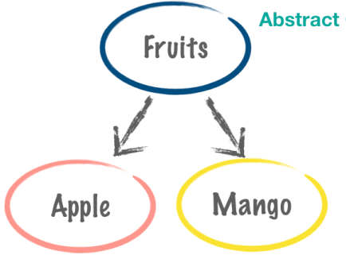
Abstract Classes
Classes that cannot be instantiated (a class with no objects), because:
It is Incomplete—derived classes must define the “missing pieces”
Too generic to define real objects
Normally used as base classes and called abstract base classes

Slide 40
Concrete Classes
Classes that can be instantiated (have objects)
Must provide implementation for every member function they define

Slide 41
Pure virtual Functions
A class is made abstract by declaring one or more of its virtual functions to be “pure”
I.e., by placing "= 0" in its declaration
Example:
virtual void draw() = 0;
"= 0" is known as a pure specifier.
Tells compiler that there is no implementation.

Slide 42
Pure virtual Functions (cont.)
Every concrete derived class must override all base-class pure virtual functions
with concrete implementations
If even one pure virtual function is not overridden
the derived-class will also be abstract
Compiler will refuse to create any objects of the class
Cannot call a constructor

Slide 43
Pure virtual Functions (cont.)
A class with even one pure virtual function is an abstract class
class A { //abstract class
public:
//pure virtual function
virtual void func() = 0;
void foo() {
cout << "A's foo" << endl;
}
};
class B:public A {
public:
void func() { //automatically virtual
cout << "B's func" << endl;
}
};
void main() {
A objA; //ERROR, cannot create object of abstract class
A* a = new B; //dynamic polymorphism
a->func(); //calls B's func
}

Slide 44
Pure virtual Functions (cont.)
class A { //abstract class
public:
//pure virtual function
virtual void func() = 0;
void foo() {
cout << "A's foo" << endl;
}
};
class B:public A {
public:
//does not override func() also an abstract class now
};
void main() {
A* a = new B; //ERROR, B is abstract
}

Slide 45
Purpose
When it does not make sense for base class to have an implementation of a function
Software design requires all concrete derived classes to implement their own function

Slide 46
Why Do we Want to do This?
To define a common public interface for the various classes in a class hierarchy
Achieve dynamic polymorphism
The heart of object-oriented programming
Simplifies a lot of big software systems
Enables code re-use in a major way
Readable, maintainable, adaptable code

